Slide 1











Linear Algebra And Differential Equations
Independent Component Analysis
PRESENTED BY,
AMAY DOSHI - R006
KESHAV KOTHARI - R021

Slide 2





Table of Contents
COCK TAIL PARTY PROBLEM
HOW DOES ICA WORK?
IMPORTANCE AND APPLICATIONS
Assumptions, Process and Output
what is ICA
Where is it used?
ADVANTAGES AND LIMITATIONS
CONCLUSION
Final thoughts
Definition, concepts, relevant theories, and examples.

Slide 3


Imagine..

Slide 4






You are at a party!
YOU ARE AT A PARTY AND THERE ARE A LOT OF SOUNDS, MUSIC, MANY PEOPLE SPEAKING, ETC. YOU CAN’T CLEARLY FOCUS ON WHAT YOUR FRIEND IS TELLING YOU. THIS IS THE COCKTAIL PARTY PROBLEM, A POPULAR EXAMPLE TO UNDERSTAND ICA.

Slide 5






Slide 6


Sound recorded at different microphones
1
2

Slide 7

Independent Component Analysis
ICA, or Independent Component Analysis, is a computational technique used in signal processing and data analysis to separate a multivariate signal into its constituent independent components. The ICA algorithm uses statistical methods to identify independent components from a mixture of signals based on the assumption that the observed signals are linear combinations of independent sources.
ICA assumes that the observed data is a linear combination of independent, non-Gaussian signals. The goal of ICA is to find a linear transformation of the data that results in a set of independent components.
Unlike principal component analysis which focuses on maximizing the variance of the data points, the independent component analysis focuses on independence, i.e. independent components.

Slide 8





Modeling of sources
WE'LL ONLY DEAL WITH THE SAMPLE( )OF THE SIGNALS,LET THESE SAMPLE COME FROM A STATIONARY DISTRIBUTION, THUS THE SOURCES ARE MODELED AS RANDOM VARIABLES

Slide 9

mathamatical formulation
x=As
A- mixing matrix (unknown), gives the coeffecient of LT
s- source vector
x- observed data modeled as LT of sorce vector
A=
a1 a2
a3 a4
Assumptions
Goal
The mixing matrrix is invertible
The sources are statistically independent
The independent components have non-guassian distribution
X & s are zero mean vectors, i.e data is centred
Goal of ICA is to find an unmixing matrix W, wich is the aproximation of A^-1, so that Ŝ ≈ S
Ŝ=Wx
here find Ŝ since the number of unknowns is greater than the number of observ. we first find W

Slide 10
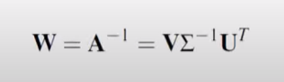
Singular Value Decomposition(SVD)
A=U∑V^T
U - orthogonal matrix[eigen vector of A(A^T)]
∑ - diagonal matrix with non-negative diagonal entries(singular value)
V - orthogonal matrix[eigen vector of (A^t)A]
Now since A is invertible U, V & ∑ are also invertible with same dimentions

Slide 11

steps to find unmixing matrix W
Covariance of observed data gives U and ∑
Independence of the sources gives V

Slide 12
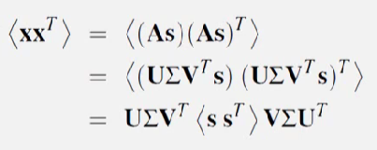
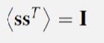
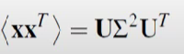
finding U and ∑
Covariance of observed data :
Covariance of source vector:
Simplified expression:

Slide 13
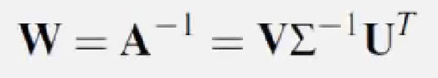
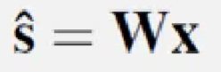
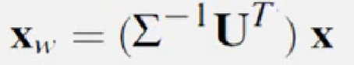
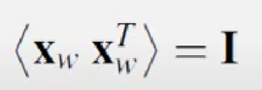
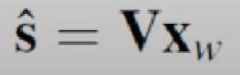
Whitening
x=As
Original formulation:
Where,
so,
define:
Xw is white:
simplified formulation:

Slide 14
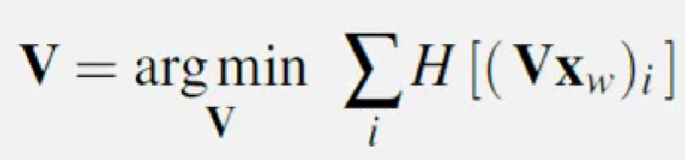
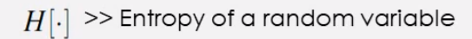
Estmating V
Maximum likelihood Estimation sources are statistically independent:

Slide 15
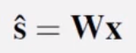

FINALLY
Now we found U, V and ∑
x=As
Original formulation:
I.e

Slide 16
Results
ICA

Slide 17










Feature | PCA | ICA
Objective | Find the directions of maximum variance | Find the independent sources underlying data
Method | Orthogonal projection | Non-orthogonal projection
Basis vectors | Eigenvectors of covariance matrix | Independent components
Orthogonality | Principal components are orthogonal | Independent components are non-orthogonal

Slide 18
Uniqueness | Not unique - different orderings yield same PC | Unique up to permutation and scaling
Applications | Dimensionality reduction, feature extraction | Blind source separation, signal processing
Limitations | Assumes Gaussian distribution of data | Assumes non-Gaussian and linearly independent data

Slide 19

Advantages
Your course grade will be determined through these assessments
HANDLES NON-LINEAR AND NON-GAUSSIAN DATA
PERFORMS BLIND SOURCE SEPARATION
FEATURE EXTRACTION AND DIMENSIONALITY REDUCTION
ICA can handle non-linear and non-Gaussian data, which is a common feature of many real-world datasets.
It can separate signals without any prior knowledge of the mixing process.
Useful tool in machine learning and data analysis.

Slide 20
Disadvantages
ASSUMES ZERO CORRELATION BETWEEN SOURCES
STRENUOUS COMPUTATION
INEXACT
ICA is a computationally expensive process and may be slow for large datasets.
Everytime an ICA program runs, we get different result and we may not get the exact outcome needed
ICA assumes that the sources are mutually independent and have zero correlation with each other, which may not always be true in practice.

Slide 21
CONCLUSION
Independent Component Analysis is a powerful technique with many applications in signal processing, data analysis, and machine learning.
The ICA algorithm is based on the principles of linear algebra and differential equations, which allow us to separate mixed signals into their original components.
ICA can be used to analyze various types of data, including audio and image signals, neurophysiological data, and financial data.
By applying ICA to complex data sets, we can uncover the underlying structure of the data, identify patterns and anomalies, and extract meaningful information that can help us to make better decisions.
The principles of ICA can be extended to other areas of data analysis, such as deep learning and natural language processing, which can enhance our ability to analyze and interpret large and complex data sets.

